Slide 1

Equal opportunity in INFN
Angela Badalà – INFN Sezione di Catania
Topics
INFN
INFN statistics
Best Practiques
Affirmative Plans

Slide 2

Pushing the frontiers of knowledge.
The secrets of the Big Bang
The INFN mission
Developing
new frontier technologies
Working together with researchers coming from all over the world
Train
the next generation of scientists and engineers

Slide 3
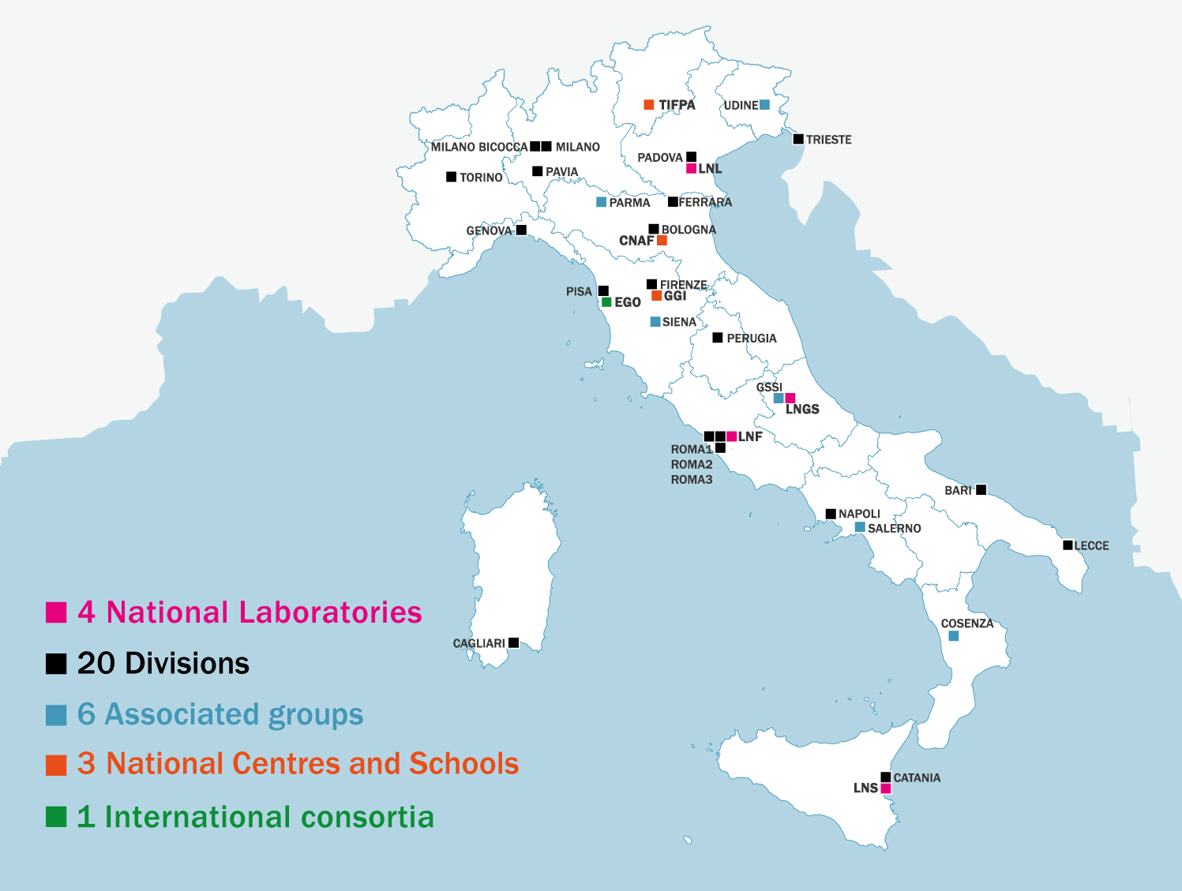
The Istituto Nazionale di Fisica Nucleare
The INFN is …
a community of about 6,500 people
INFN facilities
∼2500 INFN staff +
∼ 4000 associate personel
25% of them have PhD grants,
post-doc scholarships and research grants

Slide 4
Guarantee committee (CUG)
In 1999 INFN appointed its first Equal Opportunity Committee, currently, following Italian rules for public administration, this is the “Comitato Unico di Garanzia” (CUG).
The Garanteee Committee (Comitato Unico di Garanzia, CUG) has the task to propose actions to ensure gender equality, contrast job harassment and improve well-being at work.
It analyses sex disaggregated data, produces public annual reports to monitor the time evolution of gender gap, reviews procedures and practices to highlight gender inequalities and gender biases, proposes gender equality strategies and action plans.

Slide 5
Identifying and removing structural barriers to enhance excellence, gender equality and efficiency in research and innovation
Structural change in research institutions
Essential elements of structural change:
Knowing the institutions by gender distributions to understand the real state of parity and to monitor in time the dis-parity and the real effects of affirmative actions. (ﬁx the numbers);
Securing top-level support (ﬁx the institutions);
Generating effective management practices originating from knowledge and awareness of gender issues (ﬁx the knowledge);
https://ec.europa.eu/research/science-society/document_library/pdf_06/structural-changes-final-report_en.pdf
Notes:
To enhance excellence, gender equality and efficiency in research and innovation we need to identify structural barriers and remove them
It is absolutely crucial that the persons in managementa) are personally involved in the formulation of the institution’s gender policy and b) fully support the introduction, sustainable effect and the monitoring of the gender policy.

Slide 6

Statics of INFN staff at 31-12-2021
Analysis made by INFN-CUG and to be reported in “CUG Annual Report 2022”

Slide 7
Women in INFN
31-12-2021
Permanent Contract | TOT | M | F | F/TOT (%)
Researchers | 661 | 512 | 149 | 22
Technologists | 392 | 316 | 76 | 19
Technicians | 619 | 582 | 37 | 6
Administratives | 328 | 68 | 260 | 79
TOTAL | 2000 | 1478 | 522 | 26
Fixed-Term Contract | TOT | M | F | F/TOT (%)
Researchers | 26 | 26 | - | -
Technologists | 46 | 30 | 16 | 35
Technicians | 45 | 42 | 3 | 7
Administratives | 45 | 10 | 35 | 78
TOTAL | 162 | 108 | 54 | 33
Excluding administrative staff, i.e. the only role where they are not under-represented,
women are 16% of permanent contract employees
Excluding administrative staff women are 12% of fixed term contract employees.
No female researcher is present.
Good fraction of female in technologist role.

Slide 8
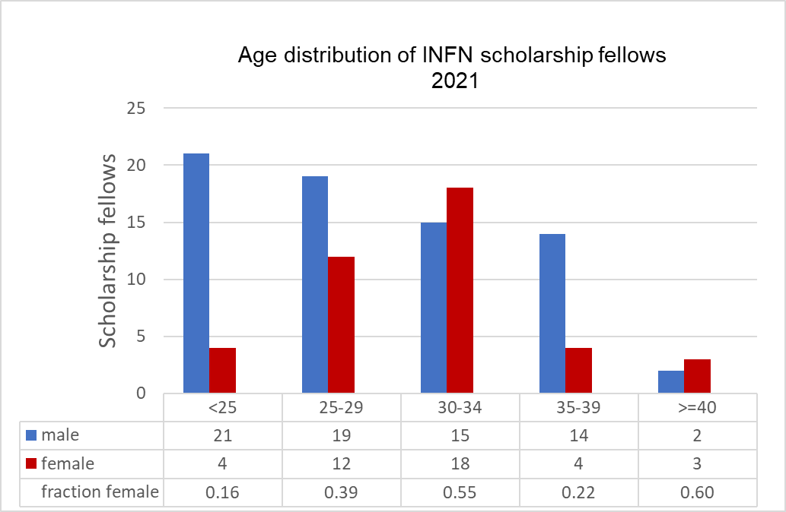
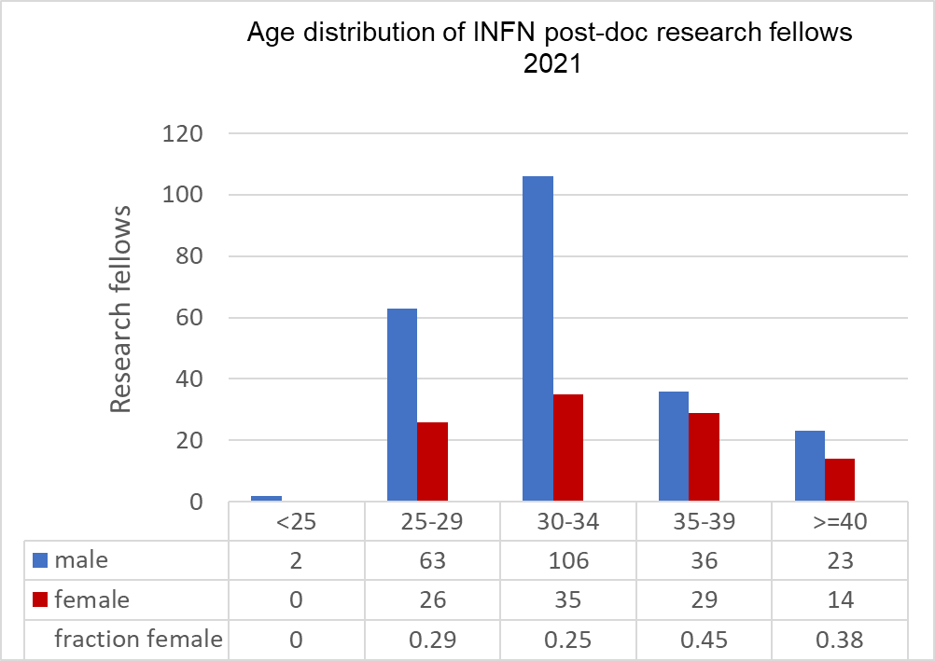
INFN people in training
112 Scholarship fellows (41F + 71M)
334 post-doc research fellows (104F + 230M)
50% of scholarship fellows is older than 30 years. Five people are older than 40 years.
~ 11% of post-doc research people is older than 40 years
Notes:
In 2021 new INFN rules have been approved to avoid/minimize people working in a lower job category than appropriate

Slide 9
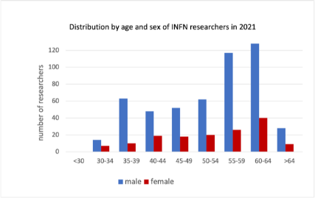
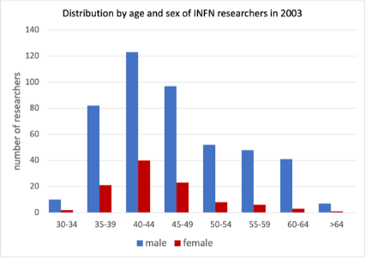
Mean age of INFN staff
Role | Mean age (years)
 | M | F
Researcher | 53 | 53
Technologist | 50 | 48
Technician | 52 | 55
Administrative | 50 | 51
Researchers 2021
Researchers 2003
The number of “young” female researchers is largely reduced respect to 2003 and they are so few that in some INFN divisions there is none.

Slide 10
Fraction of female in researcher or technologist role with permanent contract in the last 20 years
Researcher women: weak progress in 2002 - 2011.
Technologist women: weak progress in recent years mainly connected to stabilization processes (change of the contract in permanent by law)

Slide 11
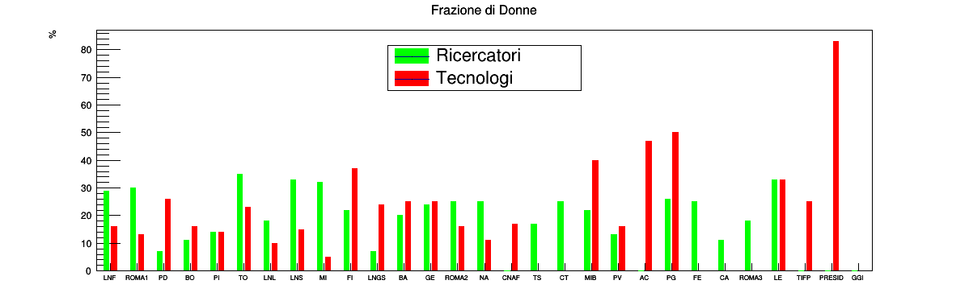
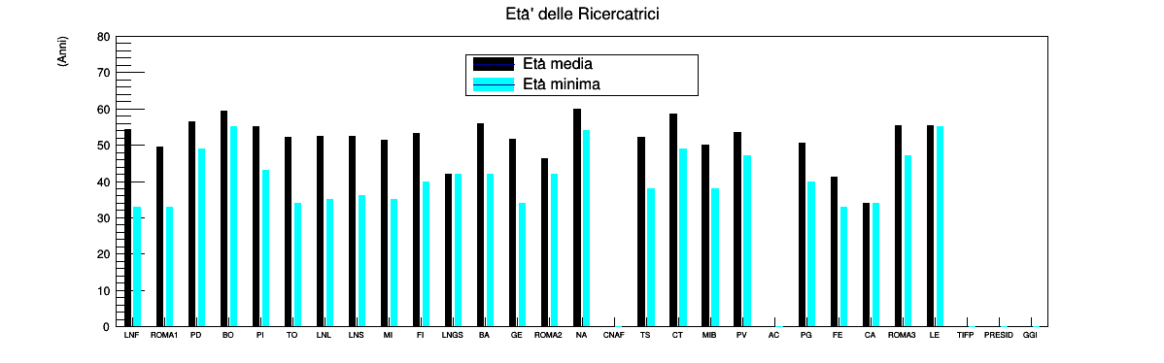
Researchers
Technologists
Large differences among the INFN facilities.
Under-rappresentation of female in researcher and technologist roles is partially resolved in some facilities/divisions.
In some facilities, also large, few women and no young woman: Minimum age ~ Mean age.
Fraction female (%)
INFN Facilities
■ Mean age
Minimum age
Age female researchers (years)
INFN Facilities

Slide 12
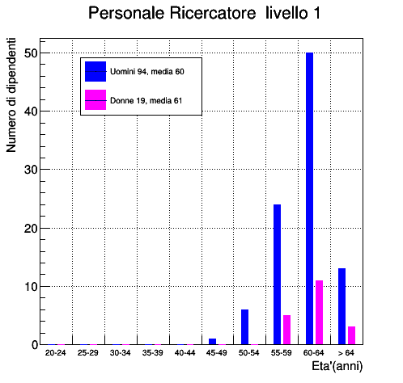
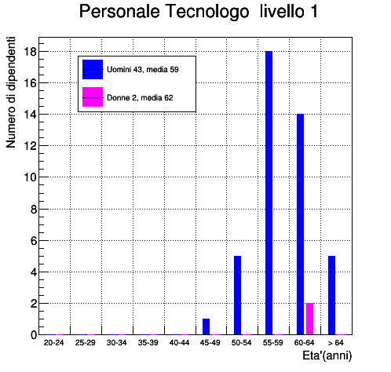
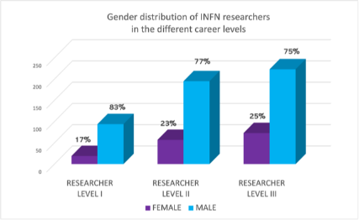
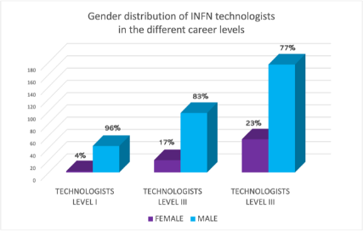
Fraction of male and female in Researcher and Technologist (R&T) career levels
Vertical segregation: fraction of women decreases at the highest career level
Women in the highest career level are older than men

Slide 13
Crystal ceiling in INFN
Profile/ Level | Researchers |  | Technologists
 | M (M/TOT_M) | F (F/TOT_F) | M (M/TOT_M) | F (F/TOT_F)
I | 94 (18%) | 19 (13%) | 43 (14%) | 2 (3%)
II | 195 (38%) | 57 (38%) | 97 (31%) | 20 (26%)
III | 223 (44%) | 73 (49%) | 176 (56%) | 54 (71%)
Total | 512 | 149 | 316 | 76
Glass ceiling index = total fraction female/ fraction female in first level
Mean Italian University = 1.6
Glass ceiling index INFN
Researchers 1.34
Technologists 4.4
Researchers
1/5 M vs 1/8 F arrive to the I (top) level
Technologists
1/7 M vs 1/33 F arrive to the I (top) level

Slide 14

The 5 research lines
and the National
Scientific Committee

Slide 15
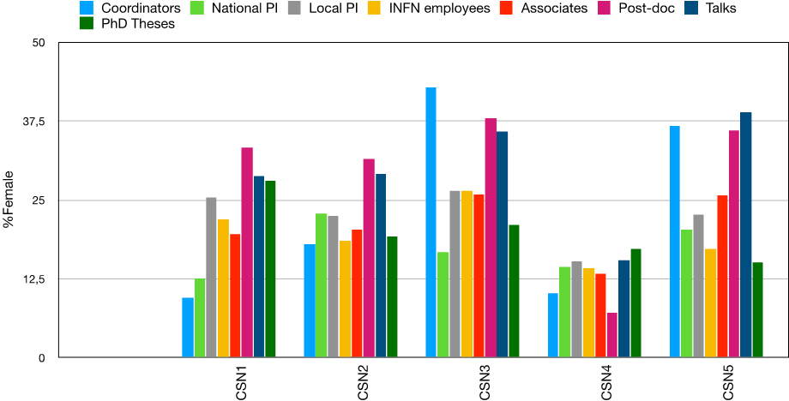
Women in INFN National Scientific Committees
Fraction of women with scientific responsibilities (national or local principal investigator or scientific coordinator) is larger or equal than the female fraction in the National Scientific Committees.
Orizontal segregation: Fraction of women in Theoretical Physics Committee is lower than in other Scientific Committees.
In the last years a decrease of the fraction of women with scientific responsabilities has been observed in NSC devoted to subnuclear physics. .
Fraction of female in post-doc positions is stable and it is > 30% (30% - 37%). In Theoretical Physics Committee it is lower than 10%.

Slide 16
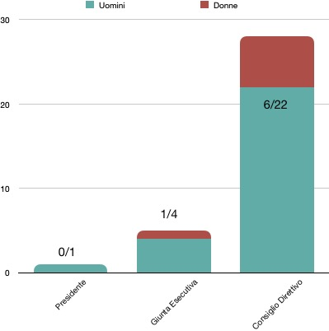
Women in INFN leadership
2003
2021
Figure da rifare
In 2021 about 20% of the components of the INFN board of Directors is a woman.
Only a woman is part of the INFN Executive Committee
No woman has been President of the INFN
In 2003 women were not present in the INFN govening body

Slide 17
INFN Documents for gender equality
Implementation of Affirmative Action Plans (Piano Triennale di Azioni Positive, PTAP) proposed by Equal Opportunity Committee (2002)
Adoption of a specific Code of Conduct to prevent job harassment and in general behaviors which are against human dignity (2003). An external figure, the Confidential Counselor, ensures the application of the Code.
Adoption of a Code of Etichs to which INFN people are required to comply in carrying out their work and of a Watchdog Committee of the Code (forse potrei eliminarlo)
Adoption of a first Gender Equality Plan (2022)

Slide 18
Affirmative Plans and GEP
General objectives: (ref.)
Increase transparency in decision-making processes and improve sharing of information
Remove the apparently-neutral institutional practices having a negative impact on women-career
Promote excellence by supporting parity and diversity
Adopt gender and generational perspectives in research activity
Improve people’s life quality by acting on human-resources management and working climate
The present INFN Affirmative Plan acts on the following areas:
1) Ensure basic components for structural changes (preparation of gender balance)
2) Training and outreach
3) Support maternity, ensuring parity and equal opportunity in recruitment and selection procedures, in nominations of decisional bodies, at every professional position and level
4) Adapt human-resources management and working climate to the needs of people in their everyday life

Slide 19
Structural changes in INFN
Some PTAP objectives since 2020 are included in the INFN Performance Plan:
Ensuring parity and equal opportunity Ensuring equal success rate for women and men in recruitment and selection procedures.
Promoting women in decision making Ensuring a fraction ≥ 25 % of the under-represented gender in scientific committees appointed by the Executive Committee. The value of the minimum fraction is increased each year. It is fixed to 30% for 2022.
Notes:
In the last 15 years has studied the success rate of women in recrutiment and selection procedures. Showing in general a low probability for male than for female. To reach the parity the requiremnt of a
Gender parity and equal opportunity are central in the European strategy of Research and Innovation https://ec.europa.eu/info/research-and-innovation/strategy/strategy-2020-2024/democracy-and-rights/gender-equality-research-and-innovation_en
EU Committee has decided that it is fundamental to have numerical objectives to arrive to have a change

Slide 20
Support to maternity
Italian law support maternity (and now also paternity) in different manner. Here only INFN supports are listed
Covering maternal leave periods of post-doctoral researchers. During maternity leave a substance equal to 80% of the salary is paid by the Social Security. INFN covers the remain 20%.
Medical insurance which covers all the expenses connected to pregnancy and childbirth for all INFN staff extended to post-doctoral research fellows and scholarship fellows
Contribution to cover the nursery school cost and recently also baby sitting expenses for children of INFN staff .
Preparation and distribution by CUG of a brochure with the indications on how accessing to state and INFN benefits for maternity

Slide 21
Some INFN achievements
a budget to
Awards reserved to female students working on theoretical physics
Training courses on equal opportunity and parity in research, Training courses to prevent discrimination and harassment and events to prevent violence against women
A research mentoring program for women (recently also for men) (talk today);
Preparation (by CUG) of a brochure “Unconscious Bias and Discrimination” whose compliance is mandatory for all components of recruitment and selection INFN panels
Aggiungere qualcosa su telelavoro/ smart working e altre iniziative che ora non ricordo
a budget to
support professional training and awards for young women researchers (10kE). Additional
financial support is given for training courses on gender equality and for a research
mentoring program for women; to cover maternal leave periods of post-doctoral
researchers; to finance an insurance for post-doctoral researchers and research fellows
which covers all the expenses connected to pregnancy and childbirth; to contribute to the
nursery school cost for children of INFN staff.

Slide 24
Backup slides

Slide 25
Gender Balance 2020 – Polytechnic of Turin
Glass ceiling index = total fraction women/ fraction women in first level
Glass ceiling index =1 means gender parity
Glass ceiling index INFN
Researchers 1.34
Technologists 4.4

